Slide 1

N e x t H I k e s I T S o l u t I o n
Title:- Data Harmonization and Insights Extraction
Name:- Ashish Pachauri

Slide 2
Introduction of Data Harmonization
Overview: Understanding the importance of consistent and visualized data.
Topics Covered:
Data Harmonization
Data Visualization
Practical Insights
This presentation explores the data harmonization process for junior data scientists , using a case study based on bike rental data. The goal is to demonstrate how the merge multiple datasets, handling missing values, and extract valuable insights.
About The Project

Slide 3
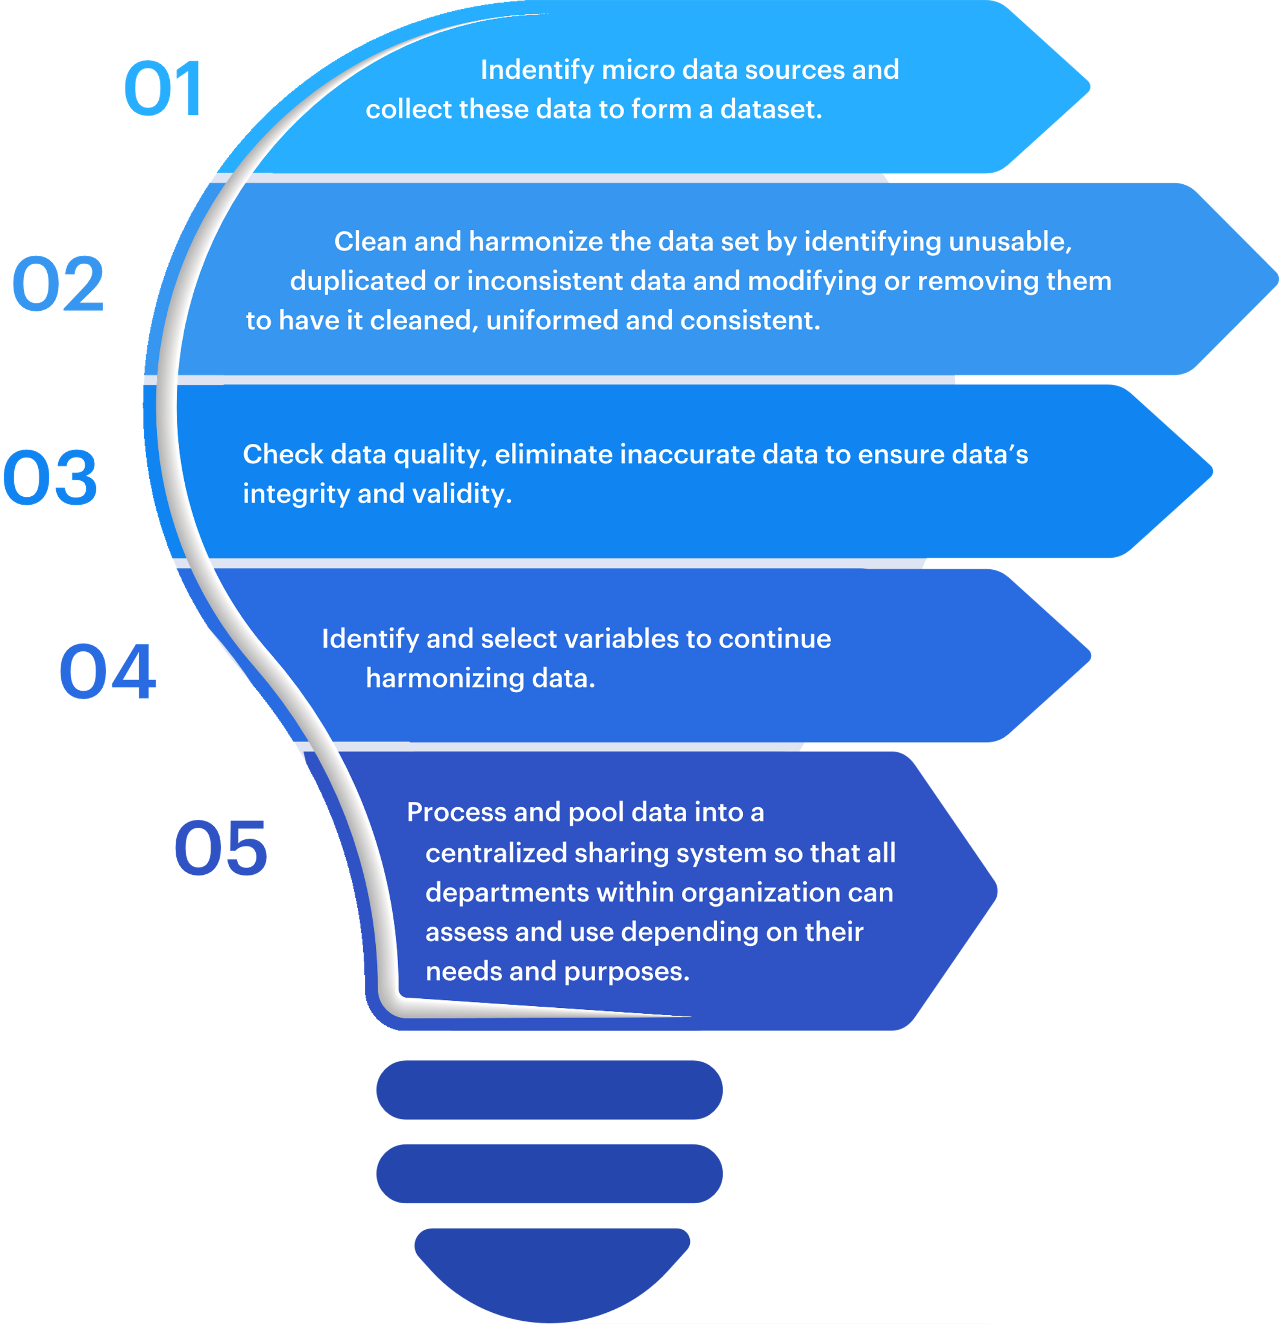
What is Data Harmonization?
Definition: The process of ensuring data consistency and compatibility from various sources.
Data harmonization is the process of selecting data, synthesizing relevant information that is qualitative and being connected between sources. The outcome is a meaningful data set, which can be analyzed to provide useful insights for business operational purposes.
Key Objectives:
Improve Data Quality
Enable Comprehensive Analysis
Phase 1 - Data Acquisition
Description:
Loading data into Python using Pandas.
Example code.
python
dataset1 = pd.read_excel(r"C:\\Users\\Dell\\Desktop\\dataset_1.xlsx")

Slide 4
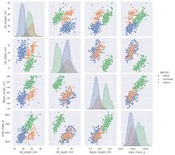
Tools and Technologies
Tools for data cleaning-:
Import python library
Import pandas library
Import numpy library
Tools for data visualization-:
Import Metplotlib for chart
Import Seaborn for advance
Using jupyter notebook

Slide 5
Data Overview
Dataset Summary:
Total Rows: 610
Key columns include:
instant, dteday, season, yr, mnth, hr
Data Structure
Table Preview:
instant | dteday | season | yr | mnth | hr | holiday | weekday | weathersit | temp
1 | 2011-01-01 | 1 | 0 | 1 | 0 | False | 6 | 1 | 0.24
Data types-:
1.Integers
2. Float
3.Datetimes
4.categorical

Slide 6
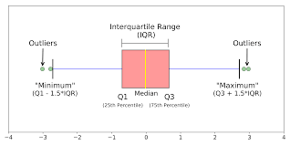
Descriptive Statistics
Statistical Summary:
Mean, standard deviation, min/max values for key variables.
Use method for statistical:
Z-score method
IQR(interquartile range)method
We detected outliers using both of these methods

Slide 7
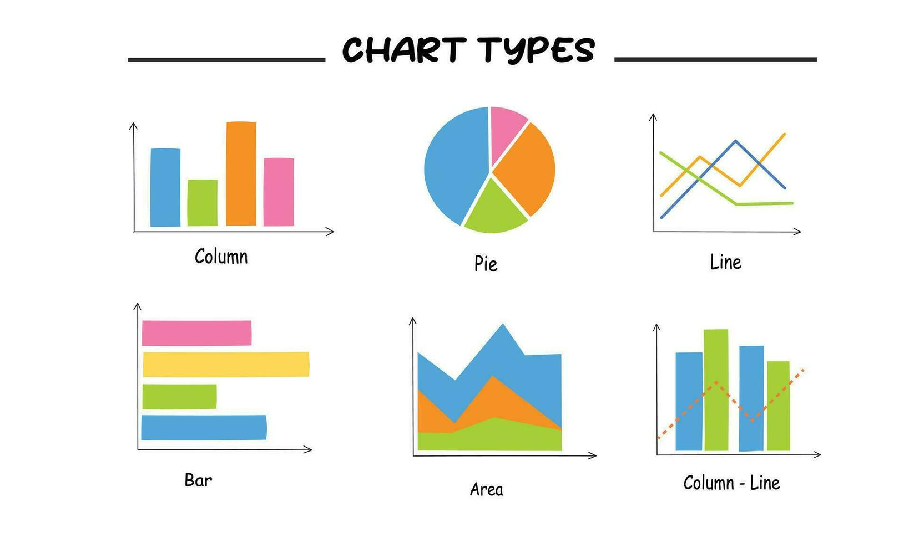
Data Visualization Overview
Importance of Data Visualization:
Converts complex data into visual formats for easier comprehension.
Facilitates better data interpretation and communication.
Enhances the ability to spot trends, patterns, and outliers.
Use Matplotlib and Seaborn for plotting.
import matplotlib.pyplot as plt
import seaborn as snb
Visualization Techniques:
Charts and Graphs: Bar charts, line charts, pie charts.
Dashboards: Interactive platforms combining multiple visualizations.
Interactive Visualizations: Allowing users to explore data dynamically.

Slide 8
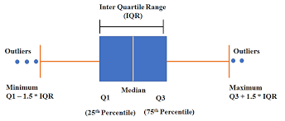
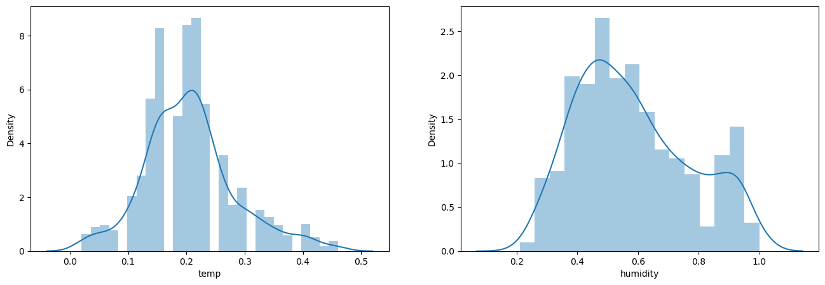
Outliers detection
To detect outliers using a graph, the most common methods are to use box plots and distplot plots.
Box plot:
How it works: A box plot displays the data distribution by showing the minimum, first quartile (Q1), median, third quartile (Q3), and maximum values. Points that fall outside the "whiskers" (typically calculated as 1.5 times the interquartile range (IQR) beyond Q1 and Q3) are considered outliers and are often marked with individual dots.
Dist plot:
Through Distplot we can find out the skewness of the data which I have done inside the data.

Slide 9
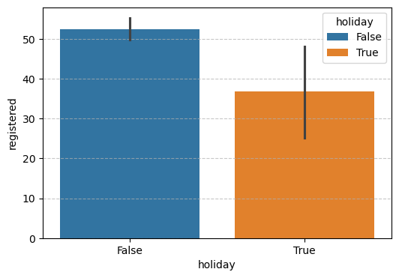
Insights from Visualization
Graphs and Charts:
BarPlot :
Here we have used bar plot on 'Holiday' and 'Registered' columns.
It shows the relationship between a numeric and a categoric variable. Each entity of the categoric variable is represented as a bar. The size of the bar represents its numeric value.
Insight:
We can see here that when the holiday false, more users are registered.
2. We can see here that when the holiday is true then less times users are registered.

Slide 10
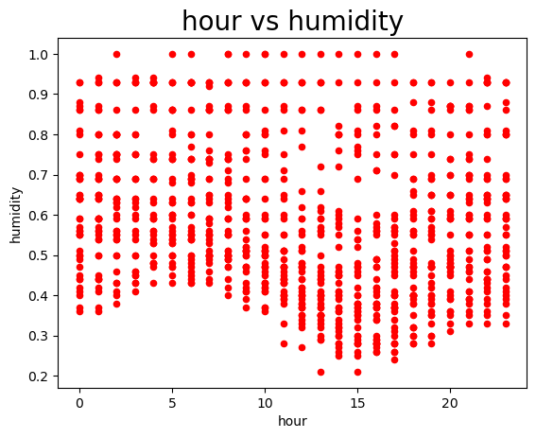
Scatter Plot:
A scatter plot is a graphical representation used to visualize the relationship between two variables by plotting data points as dots on a graph, where the position of each dot indicates the values of the two variables on the x and y axes
Basically we have used it for ‘hour vs Humidity' inside the data.
Insight:
The plot suggests that humidity is generally lower during the daytime and higher during nighttime. This pattern is typical as the temperature during the day can cause humidity to decrease, while cooler evening temperatures can increase humidity.
There's a noticeable dip in humidity around the middle of the day.
Humidity is relatively high during the early morning hours.

Slide 11
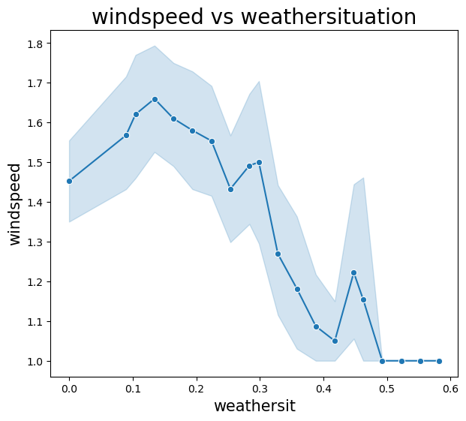
Line Plot:
I have used line plot between windspeed and weathersite.
Insight:
As the "weathersit" value increases from 0.0 to around 0.2, the windspeed shows a notable increase, peaking at around 1.7. This indicates that the windspeed is generally higher in the early stages of "weathersit."
Overall, the graph suggests that there is a specific "weathersit" range (approximately 0.2) where the windspeed is at its highest. Beyond this range, the windspeed generally decreases, indicating that certain weather situations might lead to lower windspeed.

Slide 12
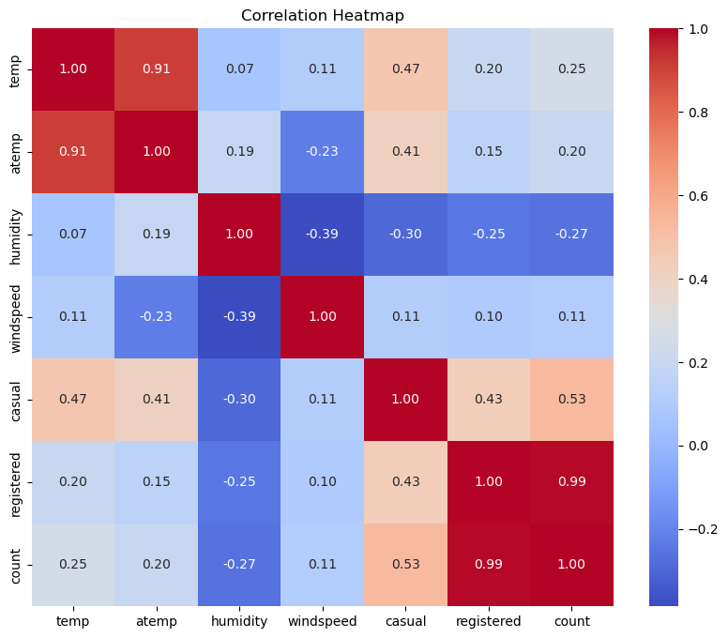
Heatmap:
Here Heatmap has done his correlation to found out.
Insight:
temp and atemp have a very high positive correlation (0.91), indicating that as the actual temperature increases, the apparent temperature also increases.
registered and count have an almost perfect positive correlation (0.99), which makes sense as the total count is highly influenced by the number of registered users.
temp and casual (0.47), meaning that higher temperatures tend to attract more casual users.

Slide 13
Conclusion
Summary of Key Points:
Data Harmonization:
Ensures consistency and accuracy in datasets by aligning and combining data from different sources.
It's the backbone of reliable data analysis and decision-making.
Data Insights:
Extracting meaningful and actionable information from data is crucial for informed decision-making.
Techniques like descriptive, diagnostic, predictive, and prescriptive analytics can provide valuable insights.
Data Visualization:
Converts complex data into visual formats that enhance understanding and communication.
Effective visualization tools and techniques help in identifying trends, patterns, and outliers quickly.
Final Thoughts:
Effective data harmonization, insights, and visualization can significantly improve business performance and decision-making.
Investing in the right tools and techniques is essential for leveraging the full potential of data.
As the field evolves, staying updated with the latest trends and technologies will be key to maintaining a competitive edge.

Slide 14
References
Websites and Online Resources:
KDnuggets (www.kdnuggets.com):
A website that provides articles, tutorials, and resources on data science and analytics.
Towards Data Science (towardsdatascience.com):
A platform with a variety of articles on data analysis, machine learning, and visualization.
Tableau Blog (www.tableau.com/blog):
Offers insights and case studies on data visualization.

Slide 15
Thank you

